Slide 1
anthropogenic emissions
Zhenqi Luo 2021.4
Notes:
https://doi.org/10.5194/acp-20-2277-2020

Slide 2
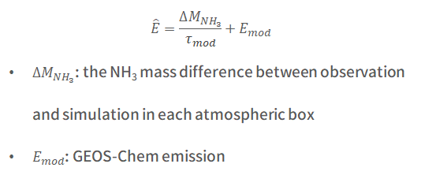
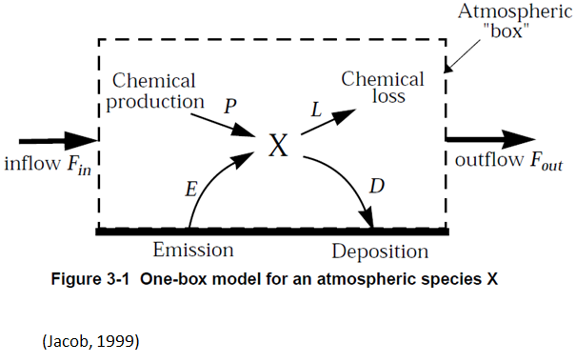
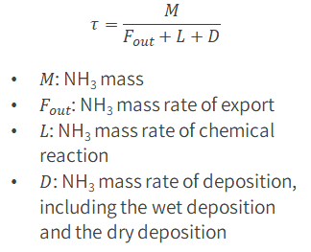

progress
1. Uncertainty analysis
Lifetime
IASI total columns concentrations
relative error
standard deviation
Export
transport (-)
Deposition
standard deviation
Modelled concentrations
standard deviation
Transportation (+)/emission ratio: 0/0.5/0.8/1/1.2/1.5/2
Number of retrievals: 0/15/25/30/35/40/50

Slide 3
Analysis & Plan
Parameter uncertainty
Relative uncertainty of emission

Slide 4
litreature

Slide 5
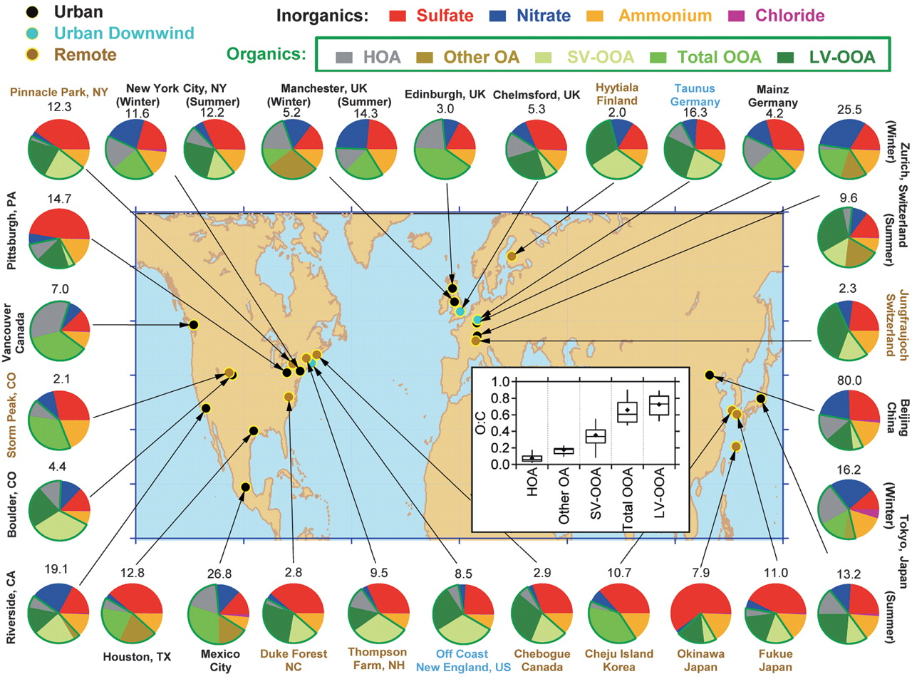
CEDS_GBD-MAPS inventory
Particle emissions——(PM 2.5)
OC
BC
SO2
NO
VOCs
NH3——agricultural activities——continuous increases in global
animal husbandry
fertilizer application
Functions
understand the range of emission impacts——inputs in CTM
develop effective strategies for pollution mitigation
Bottom-up inventories
EDGAR——European Commission Joint Research Centre
ECLIPSE——Greenhouse Gas–Air Pollution Interactions and Synergies (GAINS) model at the International Institute for Applied Systems Analysis (IIASA)
CEDS——Joint Global Change Research Institute at the Pacific Northwest National Laboratory and University of Maryland——CEDS_GBD-MAPS (1970-2017)
11 detailed emission source sectors
four fuel groups
Total mass concentration and mass fractions
(Jimenez et al., 2009) Science
Notes:
https://doi.org/10.5194/essd-12-3413-2020
the absence of widespread regulations targeting NH3 from agricultural practices
(agriculture, energy generation, industry, on-road transportation, non-road and off-road transportation, residential energy combustion, commercial combustion, other combustion, solvent use, waste, and international shipping)

Slide 6
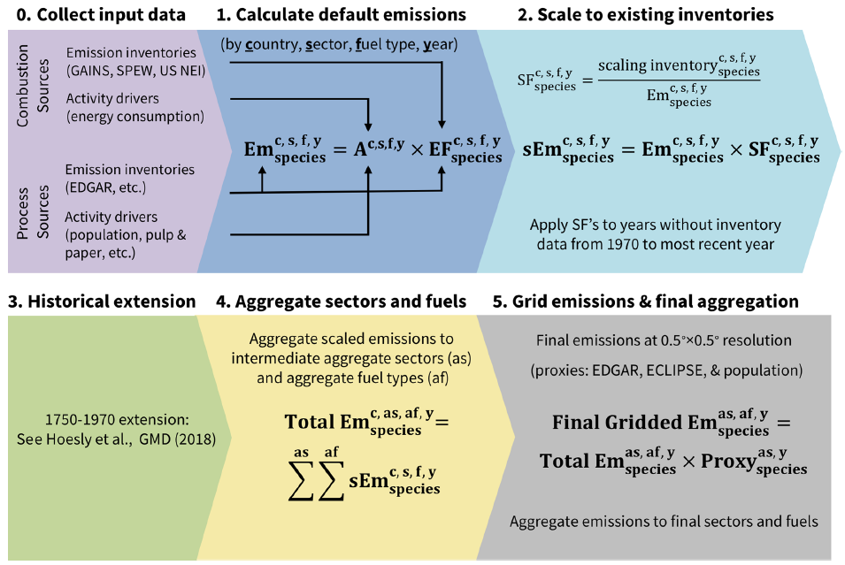
CEDS_GBD-MAPS inventory
Step 0: collection of input data
Step 1: Em = A * EF
Em: emission estimates
A: relevant activity
EF: emission factor
Step 2: scales total emission estimates
SF = scaling inventory Em/default CEDS Em
SF: scaling factors
extend SFs to fill missing data
Step 3: extends the scaled emission estimates from 1970 to 1750
Step 4: aggregates the scaled country-level emissions into gridding sectors
Step 5: allocate country-level emission estimates onto a 0.5x0.5 grid
(McDuffiez et al., 2020)
Notes:
https://doi.org/10.5194/essd-12-3413-2020

Slide 7
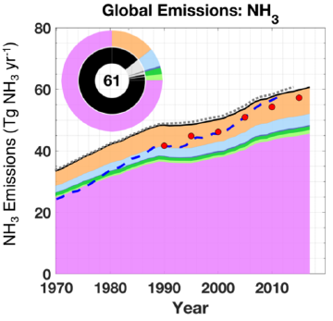
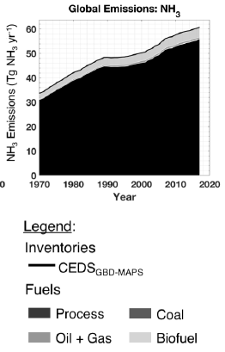
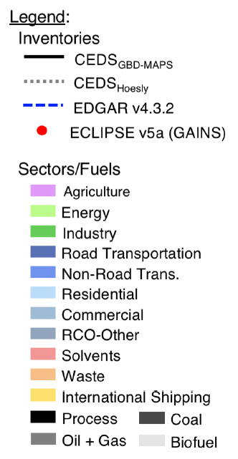
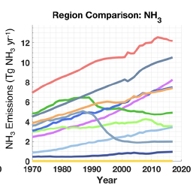
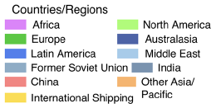
CEDS_GBD-MAPS inventory
Annual total emissions: time series from 1970–2017
Global: agriculture and waste——89%
Regions: China——20%, 12 Tg
Trend: continuously increase——81%
agricultural: 82%
waste sector: 77%
Comparison to global inventories
CEDS: unchanged
EDGAR: increase rate
GAINS: within 15%
Uncertainties
activity data
global bottom-up inventories
agricultural statistics
emission factors
regional-level scaling inventories
agricultural regions in winter: underestimated
sectoral and fuel contributions
grid
(McDuffiez et al., 2020)
Notes:
https://doi.org/10.5194/essd-12-3413-2020
China (10 Tg to 13 Tg)

Slide 8
Questions?

